Slide 1

DAMAI
DAMAI
H o t e l D a m a i R e s t a u r a n t , Y o g y a k a r t a

Slide 2
D4 TEKNOLOGI JARINGAN
SISTEM INFORMASI LAYANAN RESTO
SISTEM INFORMASI LAYANAN RESTO
KERJA BENGKEL B- 3
Sistem Informasi Layanan Resto “Damai Resto” merupakan perangkat lunak pemesanan menu makanan di restoran Hotel Jogja-Damai berbasis desktop. Aplikasi ini digunakan untuk memudahkan pengunjung restoran dalam memesan makanan dan minuman secara online. Termasuk dpat mengetahui informasi detail terkait pemesanan makanan dan minuman, mengetahui waktu tunggu, serta dapat mencetak bukti pembayaran sendiri.
Aplikasi ini, selain digunakan oleh pelanggan juga digunakan oleh operator dan admin. Operator dan Admin disini berperan untuk mengelola aplikasi dan transaksi. Operator dapat mengatur data menu pada aplikasi serta dapat melihat informasi pesanan oleh pelanggan serta laporan menu yang terjual. Admin dapat melihat semua layanan yang ada pada aplikasi serta dapat mengatur data user meliputi username, password, dan status.
WRITE HERE SOMETHING ABOUT

Slide 3
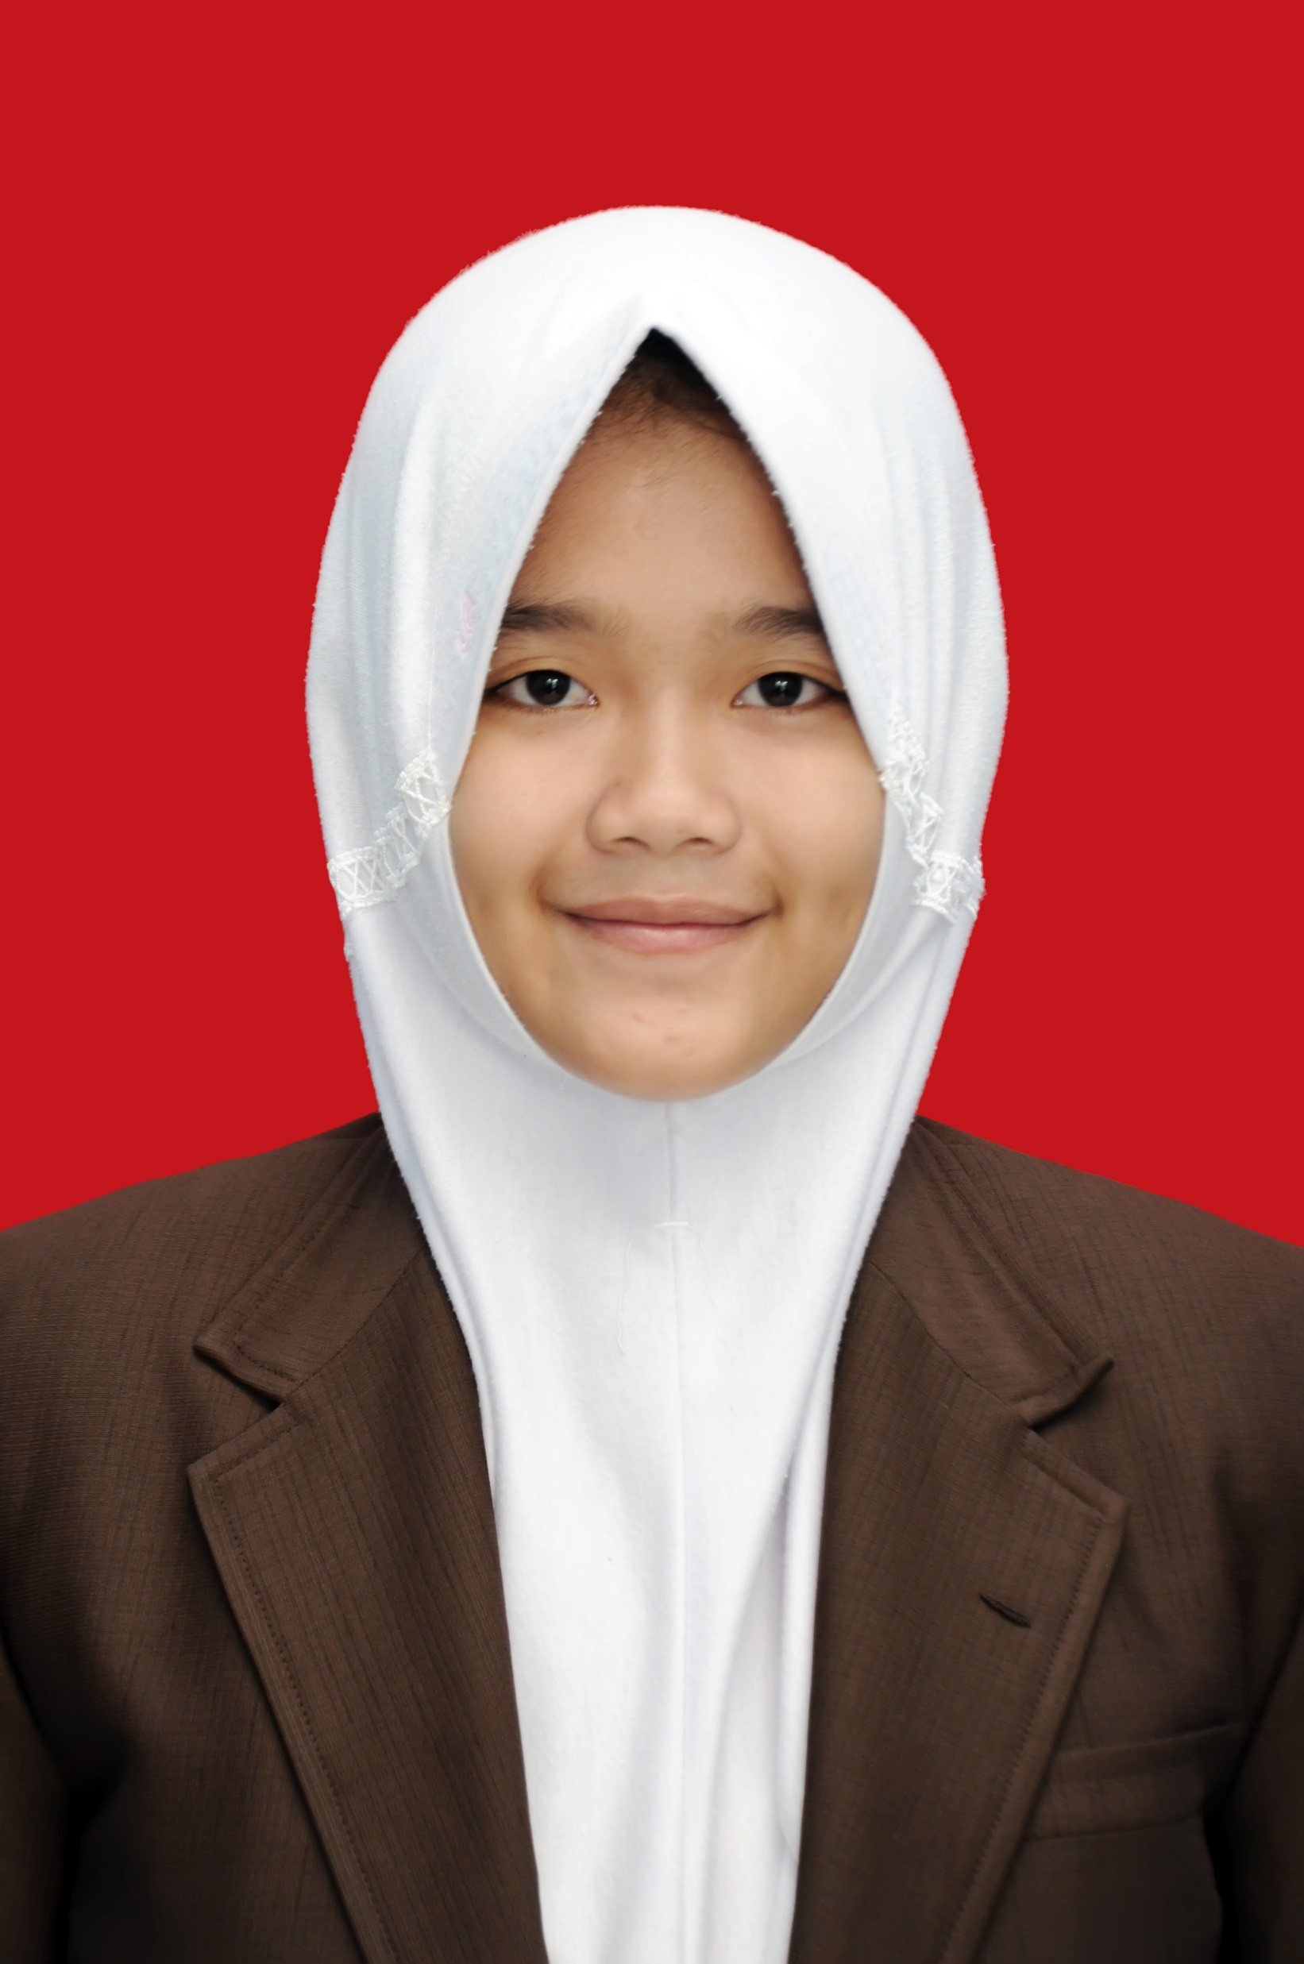
MEET THE TEAM!
Arif Hidayat
16/400617/SV/11121
FRONT END & BACK END
PHOTO NOT AVAILABLE
JOB DESC
MEET THE TEAM!
Leriana Thufailah
16/396791/SV/10975
DESIGN UI/UX
JOB DESC

Slide 4
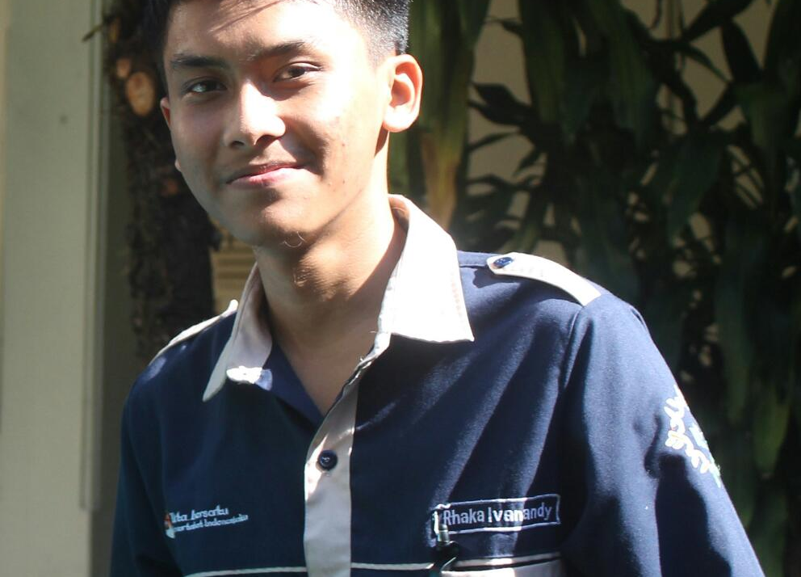
MEET THE TEAM!
Rhaka Ivanandy S.
16/396076/SV/10289
DATABASE
JOB DESC
MEET THE TEAM!
Amalia Yusriyani
PHOTO NOT AVAILABLE
16/400614/SV/11118
SYSTEM ANALYST
JOB DESC

Slide 5
JOB DESCRIPTION
D4 TEKNOLOGI JARINGAN
JOB DESCRIPTION
KERJA BENGKEL B- 3
System Analyst – Amalia Yusriyani
- Membuat analisa system (UML; Use Case, Diagram Activity, Class Diagram, Flowchart)
- Notulensi dan Timeline pengerjaan
Design – Leriana Thufailah Hidayat Putri
- Logo Apps
- Membuat Design Applikasi
- Menyusun Dokumentasi
Database – Rhaka Ivanandy Sudrajat
- Analisa kebutuhan data pada system (relasi)
- Membuat ERD
- Membuat Database
Front End & Back End – Arif Hidayat
- Membuat Implementasi design program
- Testing
WRITE HERE SOMETHING ABOUT

Slide 6
D4 TEKNOLOGI JARINGAN
KEBUTUHAN PENGGUNA SISTEM
KEBUTUHAN PENGGUNA SISTEM
KERJA BENGKEL B- 3
ADMIN
OPERATOR
PENGGUNA
Admin dapat mengubah fitur – fitur mayor serta dapat menyunting user
Operator dapat melakukan perubahan data pada applikasi resto, untuk bagian input meliputi pengisian daftar menu baru, harga dan stok. Bagian output fasilitas pelaporan.
Pengguna dapat melihat menu yang tersedia berdasarkan harga dan stoknya, melakukan pemesanan secara online, serta mencetak bukti pemesanan.
WRITE HERE SOMETHING ABOUT
WRITE HERE SOMETHING ABOUT

Slide 7
ANALISIS KEBUTUHAN
D4 TEKNOLOGI JARINGAN
ANALISIS KEBUTUHAN
KERJA BENGKEL B- 3
FUNGSIONAL SISTEM
NON FUNGSIONAL SISTEM
Dapat mengelola data stok menu dan harga melalui layanan FOOD MANAGEMENT
Dapat merekap transaksi keuangan yang melalui layanan CHECKOUT yang dilakukan oleh pelanggan
Dapat mencetak bukti pemesanan oleh pelanggan.
Dapat menyimpan database username dan password untuk masing – masing user
Sistem memiliki tampilan elegan
Sistem memiliki layanan yang mudah dimengerti
WRITE HERE SOMETHING ABOUT

Slide 8
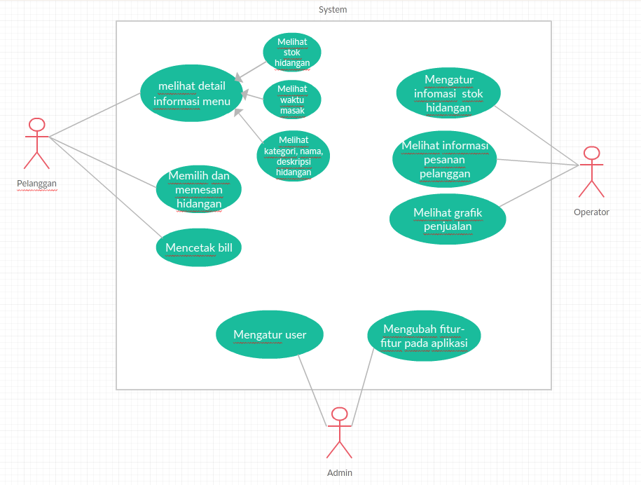

USECASE
D4 TEKNOLOGI JARINGAN
USECASE
DESKRIPSI
01
KERJA BENGKEL B- 3
02
04
06
Notes:
To change the image behind the Mock up.
Select the layer - > Right Click -> Send to Back -> Delete the image -> Drag & Drop your Own Picture -> Send to Back (again)

Slide 9
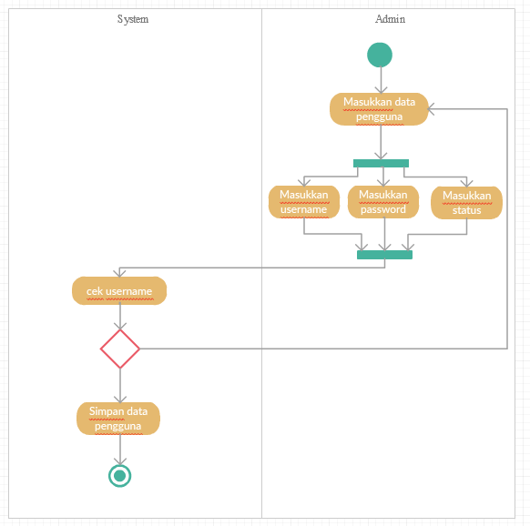
DIAGRAM ACTIVITY
D4 TEKNOLOGI JARINGAN
DIAGRAM ACTIVITY
01
KERJA BENGKEL B- 3
02
04
06
Mengubah Fitur oleh Admin
Notes:
To change the image behind the Mock up.
Select the layer - > Right Click -> Send to Back -> Delete the image -> Drag & Drop your Own Picture -> Send to Back (again)

Slide 10
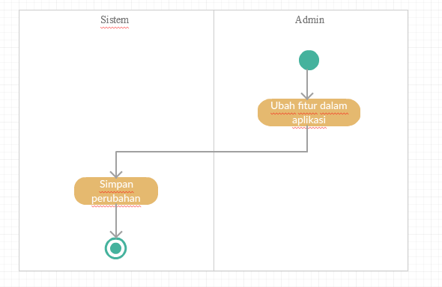
DIAGRAM ACTIVITY
D4 TEKNOLOGI JARINGAN
DIAGRAM ACTIVITY
01
KERJA BENGKEL B- 3
02
04
06
Login user (pengguna)
Notes:
To change the image behind the Mock up.
Select the layer - > Right Click -> Send to Back -> Delete the image -> Drag & Drop your Own Picture -> Send to Back (again)

Slide 11
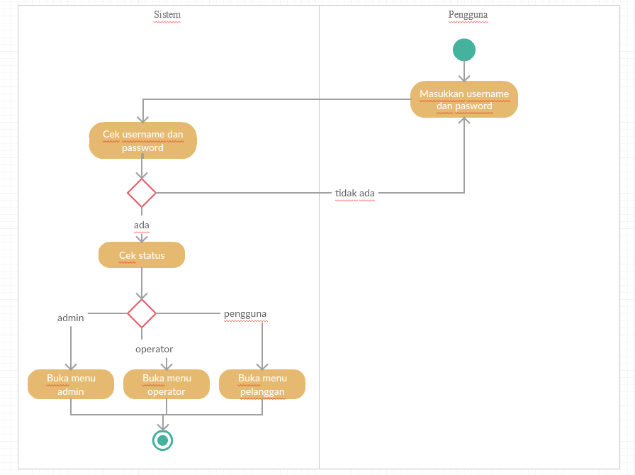
DIAGRAM ACTIVITY
D4 TEKNOLOGI JARINGAN
DIAGRAM ACTIVITY
01
KERJA BENGKEL B- 3
02
04
06
Mengubah data menu
Notes:
To change the image behind the Mock up.
Select the layer - > Right Click -> Send to Back -> Delete the image -> Drag & Drop your Own Picture -> Send to Back (again)

Slide 12
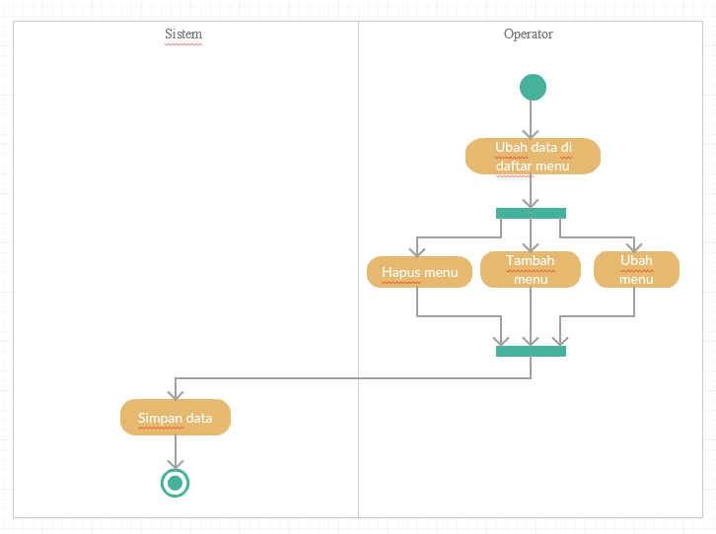
DIAGRAM ACTIVITY
D4 TEKNOLOGI JARINGAN
DIAGRAM ACTIVITY
DESKRIPSI
01
KERJA BENGKEL B- 3
02
04
06
Kasir oleh operator
Notes:
To change the image behind the Mock up.
Select the layer - > Right Click -> Send to Back -> Delete the image -> Drag & Drop your Own Picture -> Send to Back (again)

Slide 13
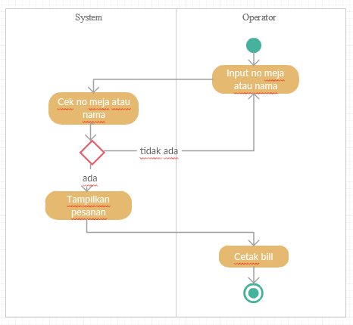
DIAGRAM ACTIVITY
D4 TEKNOLOGI JARINGAN
DIAGRAM ACTIVITY
DESKRIPSI
01
KERJA BENGKEL B- 3
02
04
06
Memesan menu oleh pelanggan
Notes:
To change the image behind the Mock up.
Select the layer - > Right Click -> Send to Back -> Delete the image -> Drag & Drop your Own Picture -> Send to Back (again)

Slide 14
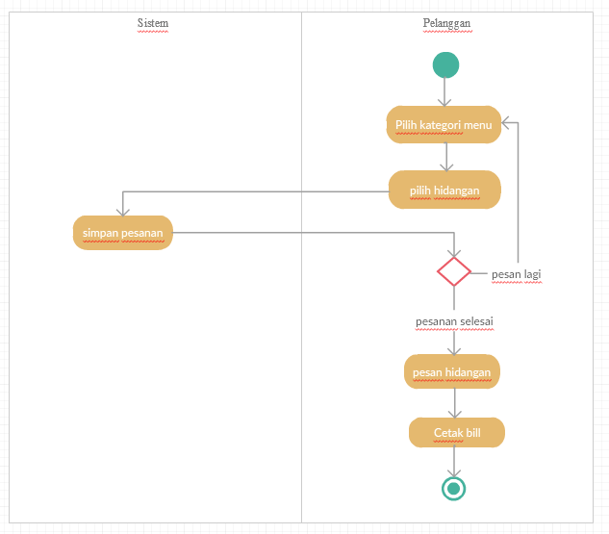
DIAGRAM ACTIVITY
D4 TEKNOLOGI JARINGAN
DIAGRAM ACTIVITY
DESKRIPSI
01
KERJA BENGKEL B- 3
02
04
06
Pemesanan Activity
Notes:
To change the image behind the Mock up.
Select the layer - > Right Click -> Send to Back -> Delete the image -> Drag & Drop your Own Picture -> Send to Back (again)

Slide 15
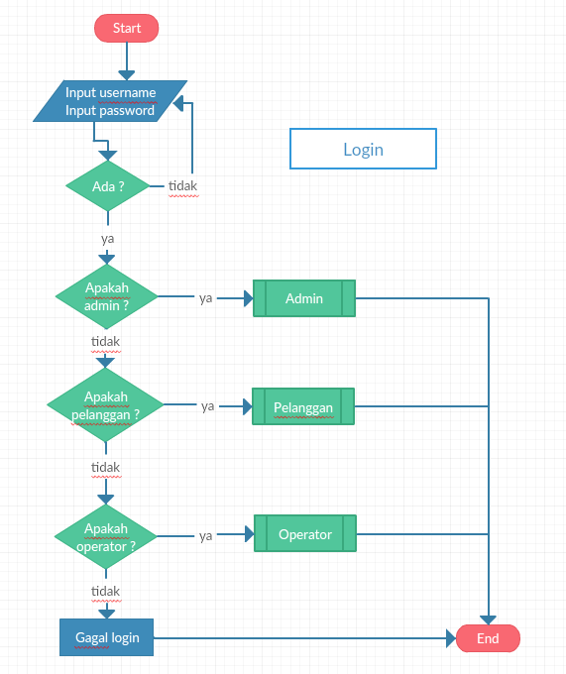
FLOW CHART
D4 TEKNOLOGI JARINGAN
FLOW CHART
DESKRIPSI
01
KERJA BENGKEL B- 3
02
04
06
Login
Notes:
To change the image behind the Mock up.
Select the layer - > Right Click -> Send to Back -> Delete the image -> Drag & Drop your Own Picture -> Send to Back (again)

Slide 16
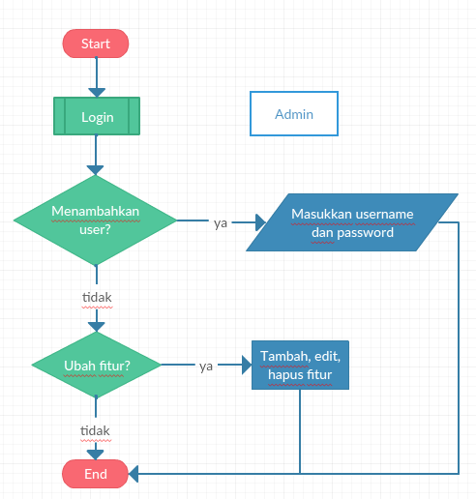
FLOW CHART
D4 TEKNOLOGI JARINGAN
FLOW CHART
DESKRIPSI
01
KERJA BENGKEL B- 3
02
04
06
Admin
Notes:
To change the image behind the Mock up.
Select the layer - > Right Click -> Send to Back -> Delete the image -> Drag & Drop your Own Picture -> Send to Back (again)

Slide 17
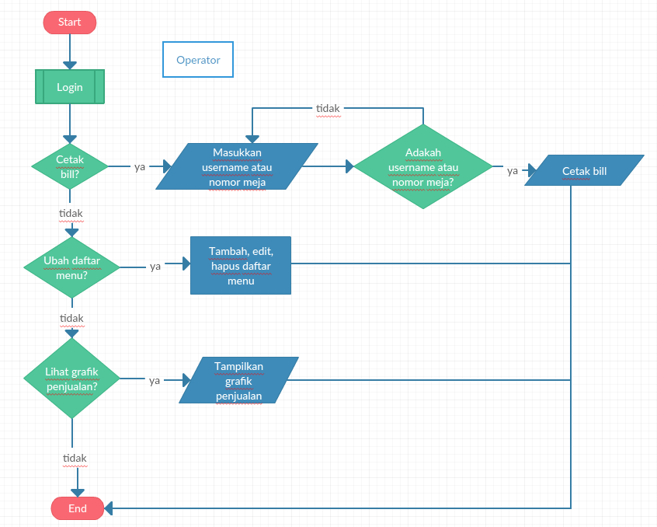
FLOW CHART
D4 TEKNOLOGI JARINGAN
FLOW CHART
DESKRIPSI
01
KERJA BENGKEL B- 3
02
04
06
Operator
Notes:
To change the image behind the Mock up.
Select the layer - > Right Click -> Send to Back -> Delete the image -> Drag & Drop your Own Picture -> Send to Back (again)

Slide 18
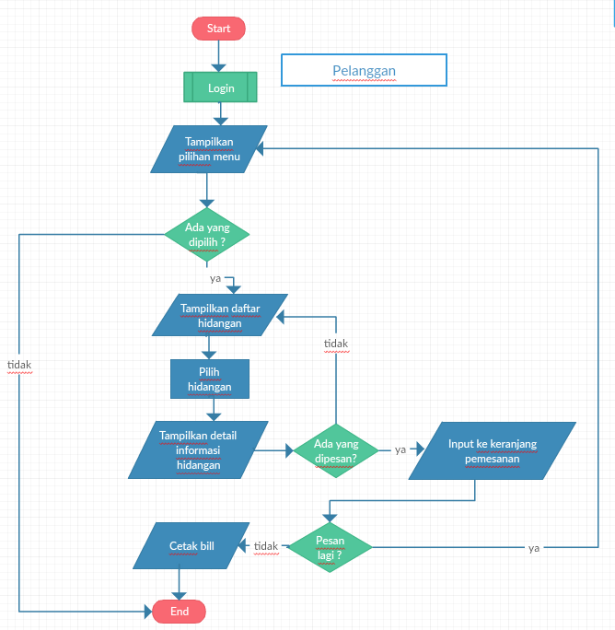
FLOW CHART
D4 TEKNOLOGI JARINGAN
FLOW CHART
DESKRIPSI
01
KERJA BENGKEL B- 3
02
04
06
Pelanggan
Notes:
To change the image behind the Mock up.
Select the layer - > Right Click -> Send to Back -> Delete the image -> Drag & Drop your Own Picture -> Send to Back (again)

Slide 19
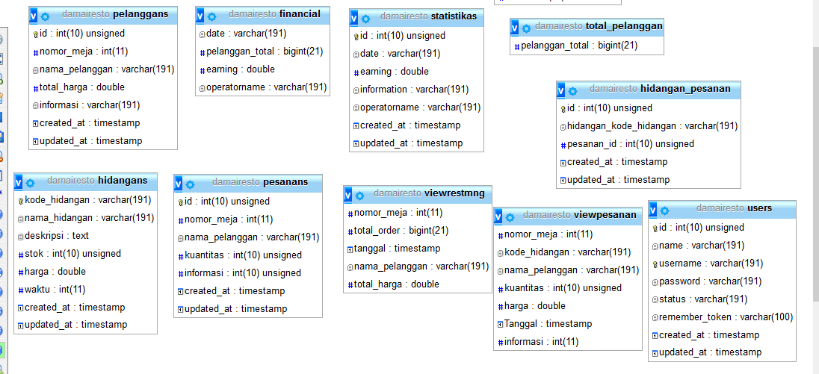
ERD
D4 TEKNOLOGI JARINGAN
ERD
DESKRIPSI
01
KERJA BENGKEL B- 3
02
04
06
Notes:
To change the image behind the Mock up.
Select the layer - > Right Click -> Send to Back -> Delete the image -> Drag & Drop your Own Picture -> Send to Back (again)

Slide 20

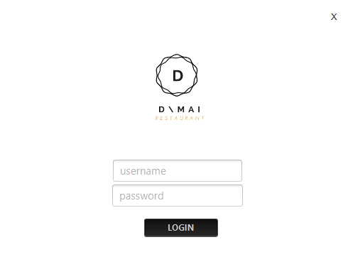
D4 TEKNOLOGI JARINGAN
DAMAI RESTO DESKTOP APP
KERJA BENGKEL B- 3
PHP FRAMEWORK
RESTFUL API
MVC (DAO)
MySQL
LARAVEL FRAMEWORK
100%
Notes:
To change the image behind the Mock up.
Select the layer - > Right Click -> Send to Back -> Delete the image -> Drag & Drop your Own Picture -> Send to Back (again)

Slide 21
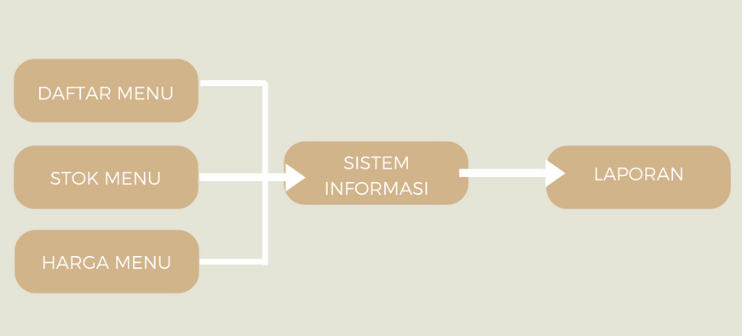
DIAGRAM BLOK SISTEM
D4 TEKNOLOGI JARINGAN
DIAGRAM BLOK SISTEM
KERJA BENGKEL B- 3

Slide 22
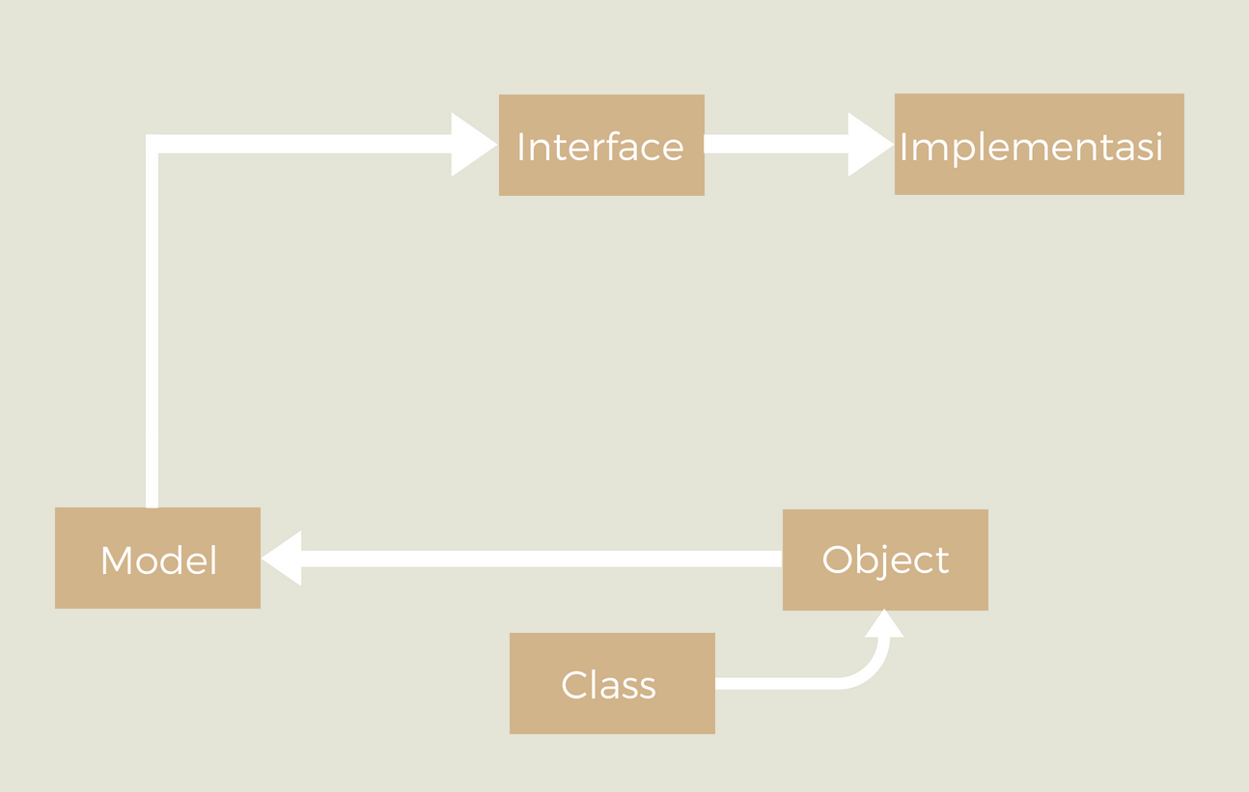
ARSITEKTUR (CLIENT)
D4 TEKNOLOGI JARINGAN
ARSITEKTUR (CLIENT)
DESKRIPSI
01
KERJA BENGKEL B- 3
02
04
06
Notes:
To change the image behind the Mock up.
Select the layer - > Right Click -> Send to Back -> Delete the image -> Drag & Drop your Own Picture -> Send to Back (again)

Slide 23
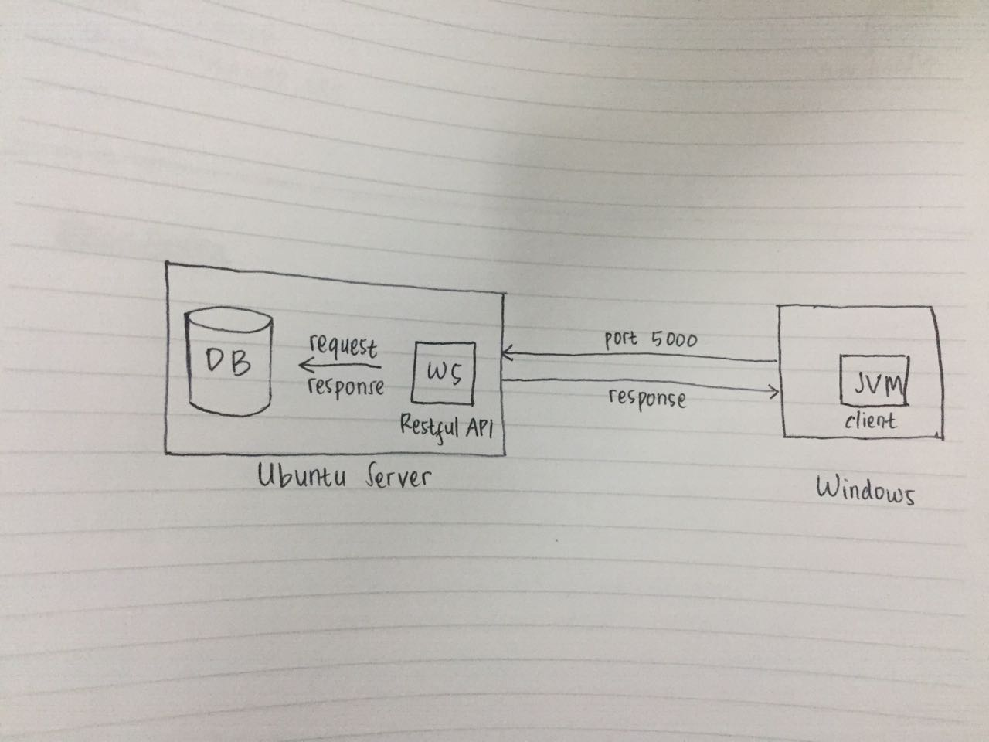
INFRASTRUKTUR JARINGA NAPPLIKASI
D4 TEKNOLOGI JARINGAN
INFRASTRUKTUR JARINGAN APPLIKASI
DESKRIPSI
01
KERJA BENGKEL B- 3
02
04
06
Notes:
To change the image behind the Mock up.
Select the layer - > Right Click -> Send to Back -> Delete the image -> Drag & Drop your Own Picture -> Send to Back (again)

